Slide 1

Introduction to Game Design
What it is

Slide 2
What is Design
Design /dɪˈzʌɪn/ noun noun: design; plural noun: designs
1. a plan or drawing produced to show the look and function or workings of a building, garment, or other object before it is made.
2. a decorative pattern.
3. purpose or planning that exists behind an action, fact, or object

Slide 3
What is Game Design then?

Slide 4
Game Design job description
Game development is the process of manifesting a producer and director’s ideas into reality. The driving force behind this process, which provides detailed direction and motivation to our entire staff from artists to programmers, is our team of game designers. No matter how talented your staff is, they can’t create a truly classic game without strong direction. As a game designer, you won’t make visuals. You won’t compose music. But your ideas will shape the world of the game most directly of all.
Platinum Games Game Design job description 2019

Slide 5
Game designers make the conscious decisions that shape the player experience

Slide 6
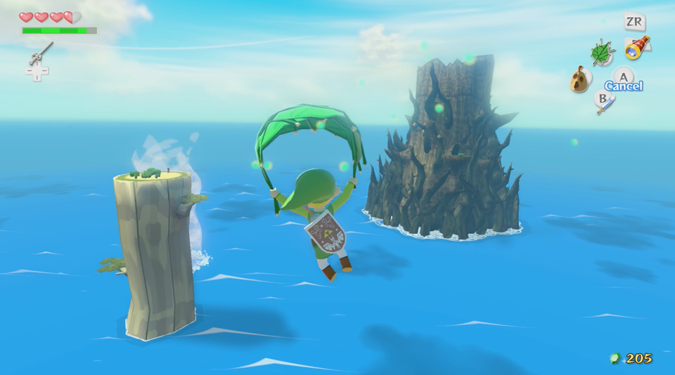

Slide 7

Is this good design?

Slide 8
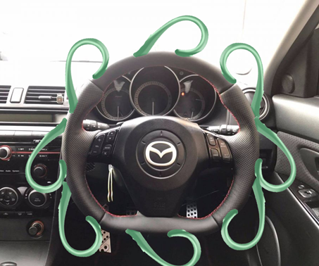
Is this good design?

Slide 9
Good game design is contextual
Developer goals
Player goals
Art style
Themes
Tone
Just so many other things

Slide 10
The Design Process
Empathize
Ideate
Test
Define
Prototype

Slide 11
Empathize
Designer tries to empathize with the player
Who is the player?
Likes, dislikes
Accessibility
Expectations

Slide 12
Define
The Designer defines what the user needs
They player needs to know how much health the player has
The player needs to know how much exp they need before the next level
The player needs to understand this mechanic before playing the level

Slide 13
Ideate
Once a problem is defined generate solutions
Research
More research
Brainstorming
Discussion

Slide 14
Prototype
Implement the idea in the most efficient way possible
Using primitives (cubes, spheres etc)
Creating test levels
Have a experience directed to testing out an idea

Slide 15
Test
Show people!
Gather feedback
Justify what feed will be used / rejected and why
Repeat the process!

Slide 16
Game Design everywhere!
Level designers
Combat designers
System designers
Narrative designers
Tool designers
And more

Slide 17
